Slide 1
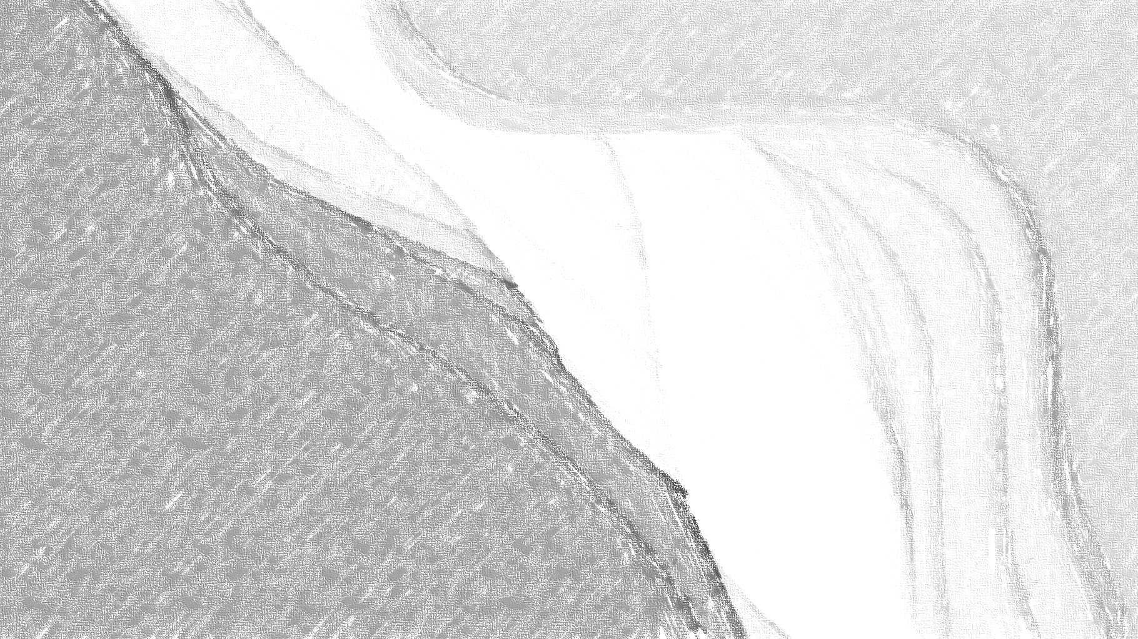
IIPA Level III
Case Studies

Slide 2
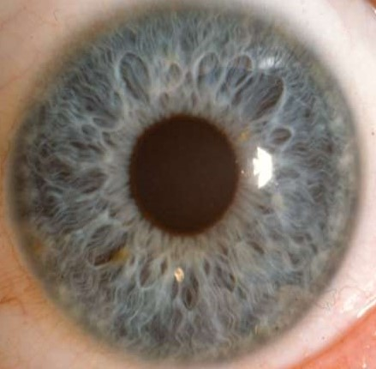
Based on the iris types in RAYID, what is the personality type of this iris?
Shaker-Jewel
Stream-Jewel
Shaker-Flower
Flower
Notes:
Shaker (driven) + tight fibers, lacuna, and pigment + Jewel (verbal - pigments) =Shaker Jewel (more jewel than lacuna)
Stream (mental) straight fibers + Jewel (verbal) pigments = Stream Jewel
Shaker (driven-lacuna, pigment, straight fibers) + Flower (emotion-lacuna) = Shaker Flower (more lacuna than pigment)
Flower type- lacuna with no pigment present.

Slide 3
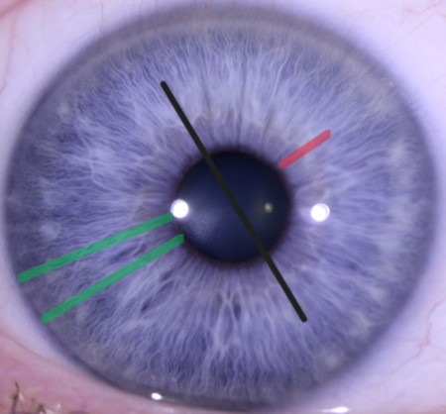
Think of Opposites Attract.
Look at the black line.
Look across the iris on the line.
What is on the opposite sides?
What is the term used?
Hand-Mouth
Cerebellum-Uterus
Axilla-Sacrum
Ear-Bladder
Notes:
Cerebellum-Uterus
1. Line of balance, coordination or vertex-foot line.
2. Disharmony line
3. Nose-diaphragm line
4. Ear-bladder line
5. Right: cerebellum-uterus line
6. Left: cerebellum- rectum line
7. Mouth-hand line
8. Axillary cross or line of support

Slide 4
Look at the short red line.
When thinking about Embryology in relation to the iris, what organ would possibly be affected?
Neck
Eye
Tonsils
Larynx
Notes:
Tonsils

Slide 5
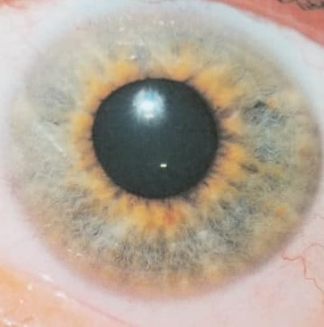
Think about Multidimensional Iridology.
When looking at the pupil flatness, what area do you notice?
Religion
Cosmic Energy
Family
Pleasure
Notes:
Cosmic Energy

Slide 6
Which syndrome does this person most closely match?
Roemheld
Cardio Renal
Cardio Abdominal
Roemheld and Cardio Abdominal
Notes:
Roemheld: This sign can be seen in both eyes, laterally. Lateral collarette appears “ballooned” and displaced. Named after Ludwig Roemheld, who first described this sign as a gastro-cardiac complex. Flatulence and bowel distention due to excessive gas production of the upper abdomen, transverse, and colon and splenic flexure.
Cardio Renal: Large lacuna or honeycomb crypts in the heart and kidney region.
Cardio Abdominal: Large lacuna or honeycomb crypts in the heart reaction field and another in the splenic flexure or descending colon. The collarette is very distended in the splenic flexure or descending colon.
Roemheld and Cardio Abdominal: Two syndromes together.

Slide 7
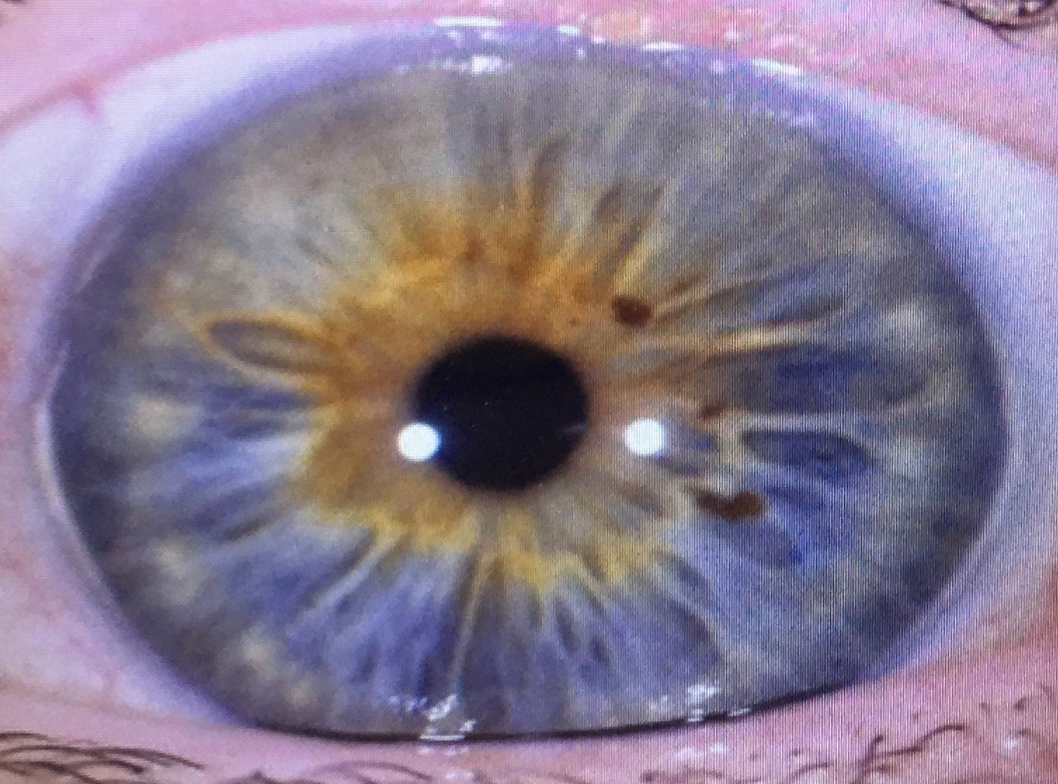
At 3:00 and 9:00 o’clock there is a white opacity at the lumbus known as:
Vogt’s Limbal Girdle
Neurofibromatosis
Fuch’s Heterochromatic Iridocyclitis
Waardenburg Syndrome
Notes:
Vogt’s Limbal Girdle: White opacities in the cornea central to the limbus. A type of calcific band with a clear peripheral zone. Different from corneal arcus or lipids in the cornea.
Neurofibromatosis: Melanocytic (pigmented) growths, yellow to brown. Well defined, dome-shaped elevation projecting from the surface of the iris. A slit lamp is the best way to view nodules to distinguish them from the general pigment, which is flat and has blurred margins. Thought not to cause concerns for vision. Most common finding in people over the age of 20 diagnosed with Type 1 Neurofibromatosis. (NF-1)
Fuch’s Heterochromic Iridocyclitis: Inflammation of the uvea, including iris, choroid, or thin back layer in the back of the eye containing blood vessels, the ciliary body which joins the iris and choroid together. Usually, only one is affected, giving a lighter appearance than the other eye.
Waaredenburg Syndrome: Different colored eyes (one blue, one brown). One eye may have a noticeable sectoral heterochromia

Slide 8
Find the Medulla Rectum line in this left eye.
This person would have more trouble with which of the following symptoms?
Balance
Thyroid/Adrenals
Vertigo
Headaches and Constipation
Notes:
Headaches and Constipation (Cerebellum/Medulla Rectum Line)
5. Right: Cerebellum-Uterus line
Left: Cerebellum(Medulla) -Rectum line
6. Hand- Mouth line
7. Axilla-sacrum or Line of Support
8. New Possibilities

Slide 9
Based on RAYID, this iris would be a:
Stream-Jewel
Shaker-Flower
Flower
Shaker-Jewel
Notes:
Stream (mental) straight fibers + Jewel (verbal) pigments = Stream Jewel
Shaker (driven-lacuna, pigment, straight fibers) + Flower (emotion-lacuna) = Shaker Flower (more lacuna than pigment)
Flower type- lacuna with no pigment present.
Shaker (driven) + tight fibers, lacuna, and pigment + Jewel (verbal - pigments) =Shaker Jewel (more jewel than lacuna)

Slide 10
How would you classify this iris based on Toni Miller’s Constitutional Diathesis presentation:
Hyper-Acidic
Febrile
Hydro-Lymphatic
Kidney-Lymphatic
Notes:
Hyper-Acidic: Icy blue fibers look merged due to heavy white plaque – looks very very white. Fibers in the humoral zone are white, as are fibers in the ciliary body. White humoral zone. The degree of loading (white thickness) determines rheumatic disposition and collagen diseases. Scurf rim may be seen. Extreme lightening of fibers. Known as overacid subtype by IIPA.
Febrile: Greenish/yellow hues and tones characterize them. They may also appear grey or slightly greenish. Steal gray or greenish hue. The febrile is a subtype of the hyper acidic diathesis. Thickened fibers meld together. Heavy plaque loading. Increased rheumatic issues – Inflammation, pain and tenderness, stiffness in the muscles and joints. This is an acquired diathesis. We know this as the Uric Acid Subtype with IIPA.
Hydro-Lymphatic (Hydrogenic): It may be seen in lymphatic or mixed irises. It can be seen in infancy within 3 months. You are either born with it or not. Tophi will not accumulate over time. 25% of the population have tophi. Toxic loading of the lymph. They do not want confrontations. They can be moody and impatient. They may complain about fluid retention. Known as Hydrogenoid Subtype with IIPA.
Kidney-Lymphatic: This diathesis also appears to have greenish or yellowish hues. There will be structural signs in the kidneys. This is what makes it different from the febrile: the structural markings. Blue iris with straw yellow pigment. Yellow structural sign in the kidney RF. Appears green to the naked eye. Yellow collarette and humoral zone. Structural marks in kidneys Tophi common may be yellow. Looks like Uric Acid Subtype from IIPA.

Slide 11
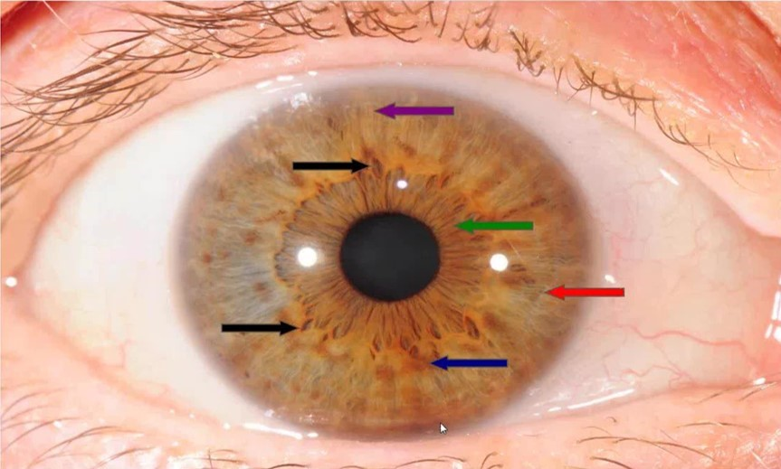
Think about the Precancerous Signs.
This iris would be a:
Psoric Constitution
Sycotic Constitution
Norris-Miliankos Constitution
None of the above
Notes:
Psoric:
1. Blue-gray iris color (lymphatic type) though it may look brown due to a central heterochromia and brown pigmentations in the ciliary zone. It will always have a blue-gray background.
2. The two pupils are often unequal in size (anisocoria)
3. Pigmentations or Central heterochromia are located in the pupillary zone.
4. The fibers in the ciliary zone are loose and /or filled with crypts. Open or closed lacuna are on or close to the collarette, indicating organ deficiencies.
5. The ciliary zone contains several dark brown melanin pigments.
Sycotic:
1. The iris is generally light brown (biliary)
2. The middle of the ciliary zone appears lighter than the rest of the iris. The iris stroma has the appearance of a white ring due to contraction furrows (anxiety tetanic)
3. The periphery of the pupillary zone and humoral zone region appear milky in color, indicating poor, conditions of bodily fluids.
4. Light colored tophi are found in the periphery of the ciliary region.
5. There is usually a tarry dark melanin pigment or tarry pigments somewhere in one iris.

Slide 12
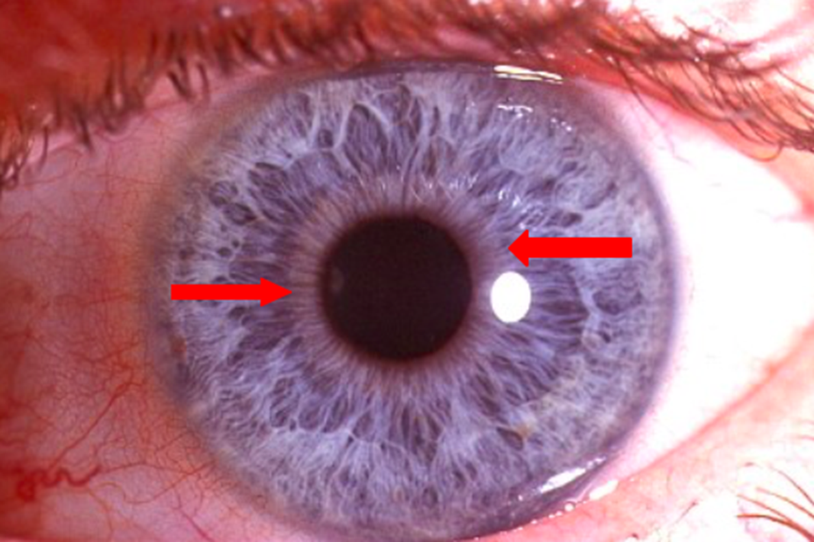
Think of the RAYID rings.
Which ring does this iris have?
Ring of Purpose
Ring of Perfection
Ring of Freedom
Ring of Determination
Notes:
Ring of Purpose: Scurf Rim
Ring of Perfection: Stomach Ring: Overacid
Ring of Freedom: Achievement – Contraction Furrows
Ring of Determination: Lipemic Ring

Slide 13
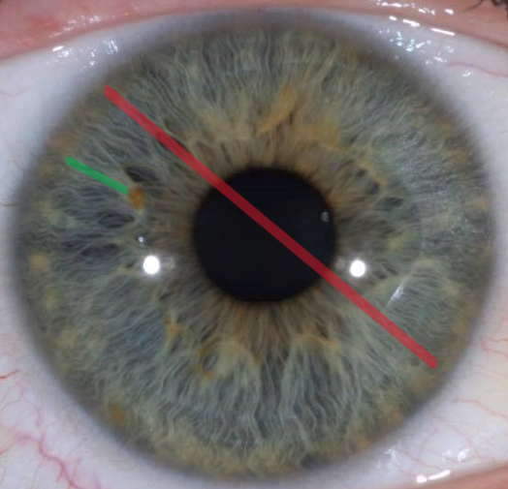
Notice the green line.
When you think about Embryology in relation to the iris, what organ could possibly be affected?
Adenoids
Heart
Bladder
Thyroid
Notes:
Thyroid

Slide 14
Think of Opposites Attract.
When you see the red line across the iris the line is the:
Disharmony Line
Ear-Bladder Line
Mouth-Hand Line
Cerebellum-Uterus Line
Notes:
Ear-Bladder Line

Slide 15
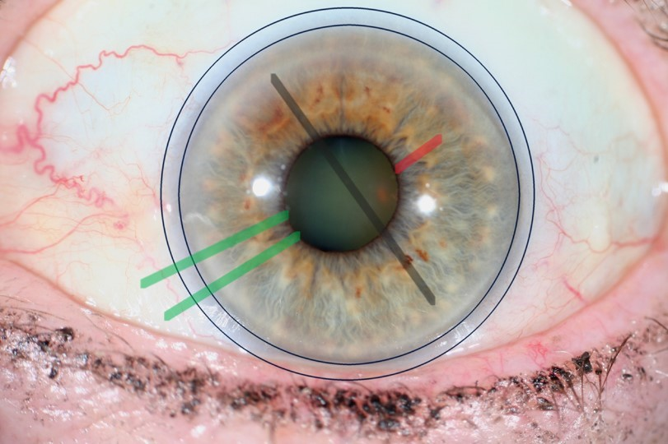
In between the green lines shows us a SpaceRisk Limbus marking that could affect what organ?
Gallbladder
Right breast
Diaphragm
Spine
Notes:
Gallbladder

